Slide 1
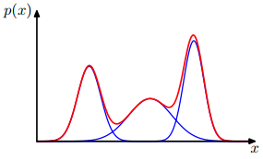
Expectation-Maximization (EM) Algorithm in K-means Clustering and Mixtures of Gaussians
Christopher M. Bishop
Microsoft Research Ltd
Pattern Recognition and Machine Learning (PRML)
2006

Slide 2
Overview
Contents
Probability theory
Mixtures of Gaussians
Conclusion
Expectation-Maximization (EM) Algorithm
K-means Clustering
Latent variables
Observed variables
Expectation-Maximization (EM)
K-means
Clustering
Maximum likelihood
Mixture Gaussian
1
Keywords
2
Image segmentation
3
4
5

Slide 3
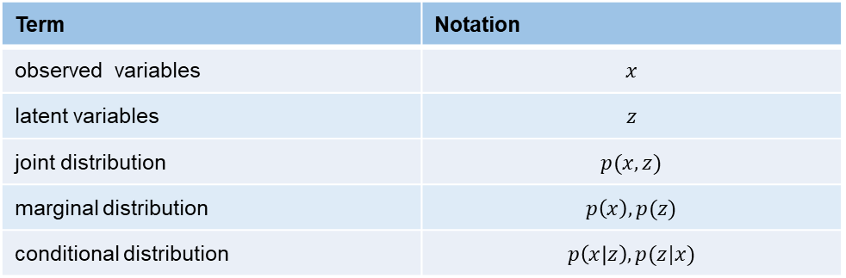
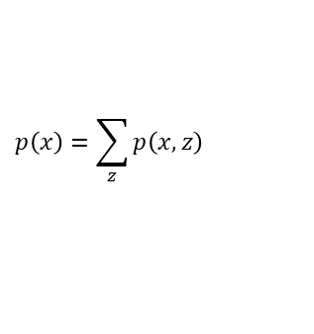
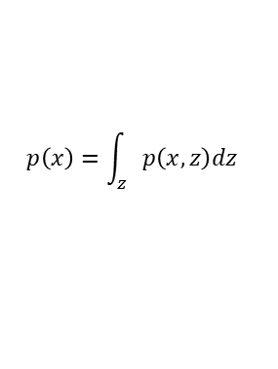
1
Probability theory
Term | Notation
observed variables | $$x$$
latent variables | $$z$$
joint distribution | $$p(x,z)$$
marginal distribution | $$p\left(x\right),p(z)$$
conditional distribution | $$p\left(x | z\right),p(z|x)$$
Solution
introducing of latent variables (hidden variables or unobserved variables)
Continuous latent variables
Discrete latent variables
What is data clustering ?
Pattern recognition problem
Unsupervised learning problem: training data without any corresponding target values.
Goal: discover groups of similar examples within the data
的
$$p\left(x\right)=\int_{z}{p\left(x,z\right)dz}$$
$$p\left(x\right)=\sum_{z}{p\left(x,z\right)}$$
Limitations of Gaussian distribution
For large D, the total number of parameters grows quadratically with D.
Unable to provide a good approximation to multimodal distributions.
Data Clustering
Nonprobabilistic Technique
K-means Algorithm (Lloyd, 1982)
Probabilistic Technique
Mixture Distributions
Discrete Latent Variables
Expectation-maximization (Em)
Gaussian Mixture Distribution
Maximum likelihood
General Form
K-means Algorithm
Notes:
Using restricted forms of the covariance matrix restrict the form of the probability density and limit its ability to capture interesting correlations in the data.

Slide 4

2
Expectation-Maximization (EM) Algorithm
Iterative Procedure → EM Algorithm
Initialize $μ_{k}$
Step 1 (Expectation Step)
(1) fixed $μ_{k}$
(2) minimize objective function $J$ w.r.t the $r_{nk}$
Step 2 (Maximization Step)
(1) fixed $r_{nk}$
(2) minimize objective function $J$ w.r.t to the $μ_{k}$
Until $J$convergence
Reference
Dempster A P, Laird N M, Rubin D B. Maximum likelihood from incomplete data via the EM algorithm [J]. Journal of the royal statistical society. 1977: 1-38.
Extension:
variational inference framework
generalized EM, or GEM
Notes:
EM算法是一种迭代优化策略，由于它的计算方法中每一次迭代都分两步，其中一个为期望步（E步），另一个为极大步（M步），所以算法被称为EM算法
基本思想：首先根据己经给出的观测数据，估计出模型参数的值；然后再依据上一步估计出的参数值估计缺失数据的值，再根据估计出的缺失数据加上之前己经观测到的数据重新再对参数值进行估计，然后反复迭代，直至最后收敛，迭代结束。

Slide 5
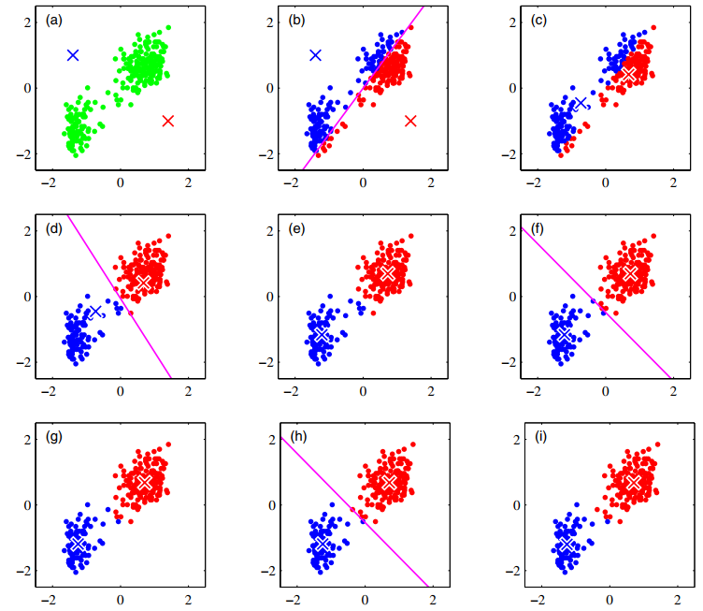
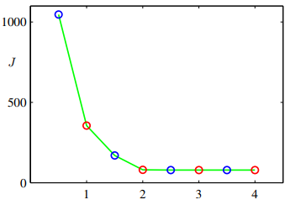






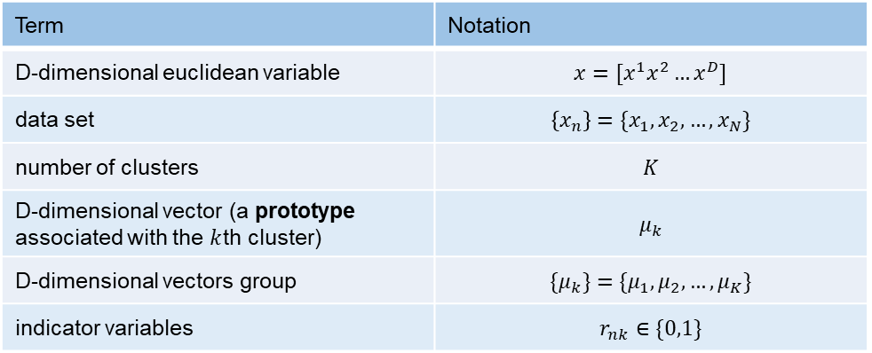



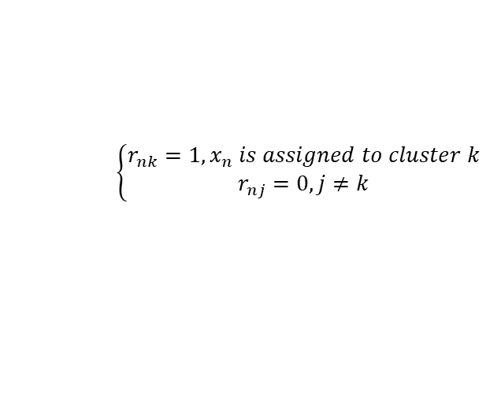

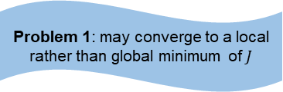



3
Problem 1: may converge to a local rather than global minimum of $J$
Problem 2: speeding up the K-means algorithm
K-means Clustering
Better Initialization: choose the cluster centres $μ_{k}$
to be equal to a random subset of $K$ data points
A batch version of k-means
Term | Notation
D-dimensional euclidean variable | $$x=[x^{1}x^{2}…x^{D}]$$
data set | $$\left\{x_{n}\right\}=\{x_{1},x_{2},…,x_{N}\}$$
number of clusters | $$K$$
D-dimensional vector (a prototype associated with the $k$th cluster) | $$μ_{k}$$
D-dimensional vectors group | $$\{μ_{k}\}=\{μ_{1},μ_{2},…,μ_{K}\}$$
indicator variables | $$r_{nk}∈\{0,1\}$$
centre $μ_{2}$
Initialize
E step
M step
Figure 9.1
Old Faithful data set
2-d Euclidean space
Perpendicular bisector
Figure 9.2
Objective Function $J$
data set
centre $μ_{1}$
E step
M step
E step
1-of-𝑲 Coding $r_{nk}$
Minimize Objective Function $J$→ Distortion Measure
Iterative Procedure → EM Algorithm
Initialize $μ_{k}$
Step 1 (E Step) minimize $J$ with respect to the $r_{nk}$ (fixed $μ_{k}$)
Step 2 (M Step) minimize $J$ with respect to the $μ_{k}$ (fixed $r_{nk}$)
Until $J$convergence
$$\left\{\begin{aligned}r_{nk}=1,x_{n} is assigned to cluster k \\ r_{nj}=0, j≠k\end{aligned}\right.$$
M step
E step
M step
E step
convergence
M step
E Step: Update $r_{nk}$
M Step: Update $μ_{k}$
all of the data points $x_{n}$ assigned to cluster $k$
the number of points assigned to cluster $k$
Notes:
目标：直观上讲，我们会认为由⼀组数据点构成的⼀个聚类中，聚类内部点之间的距离应该⼩于数据点与聚类外部的点之间的距离。 Prototype: example

Slide 6

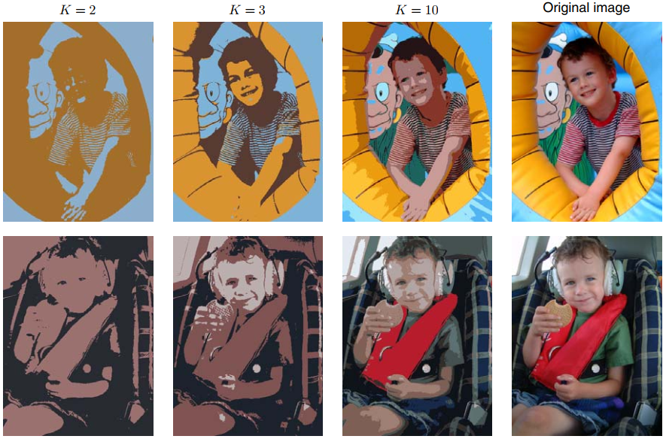





3
Problem 3: Euclidean distance as the measure of dissimilarity
K-means Clustering
On-line stochastic algorithm
Term | Notation
D-dimensional euclidean variable | $$x=[x^{1}x^{2}…x^{D}]$$
data set | $$\left\{x_{n}\right\}=\{x_{1},x_{2},…,x_{N}\}$$
number of clusters | $$K$$
D-dimensional vector (a prototype associated with the $k$th cluster) | $$μ_{k}$$
D-dimensional vectors group | $$\{μ_{k}\}=\{μ_{1},μ_{2},…,μ_{K}\}$$
indicator variables | $$r_{nk}∈\{0,1\}$$
Generalize the K-means algorithm → K-medoids Algorithm
general dissimilarity measure
E Step: Update $r_{nk}$ $O(KN)$
M Step: Update $μ_{k}$ $O({N_{k}}^{2})$ ???
$$v(x,x^{′})$$
smaller values of $K$ give higher compression at the expense of poorer image quality
1-of-𝑲 Coding $r_{nk}$
Minimize Objective Function $J$→ Distortion Measure
Robbins-monro Procedure → Regression Function
Figure 9.3
Image segmentation
K-means clustering
vector quantization
lossy data compression
$\left\{R,G,B\right\}, 8 bit, N pixels$
$24K+N\log_{2}{K}$
240×180=43200 pixels
$$\left\{\begin{aligned}r_{nk}=1,x_{n} is assigned to cluster k \\ r_{nj}=0, j≠k\end{aligned}\right.$$
43248 bits (K = 2)
86472 bits (K = 3)
173040 bits (K = 10)
24×43200=1036800 bits
Notes:
目标：直观上讲，我们会认为由⼀组数据点构成的⼀个聚类中，聚类内部点之间的距离应该⼩于数据点与聚类外部的点之间的距离。 Prototype: example

Slide 7







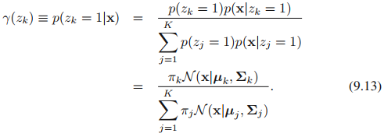





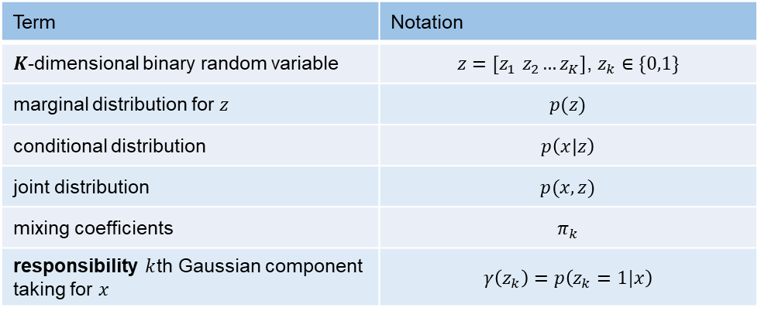
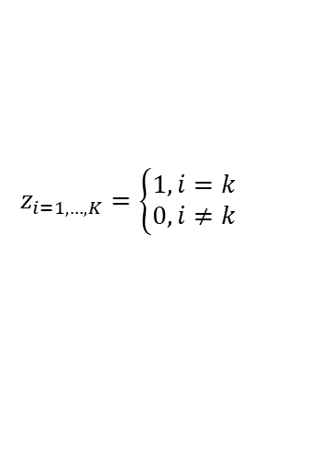


4
Mixtures of Gaussians
Gaussian mixture distribution
Term | Notation
$K$-dimensional binary random variable | $z=[z_{1}{ z}_{2}…z_{K}]$, $z_{k}∈\{0,1\}$
marginal distribution for $z$ | $$p(z)$$
conditional distribution | $$p\left(x | z\right)$$
joint distribution | $$p(x,z)$$
mixing coefficients | $$π_{k}$$
responsibility $k$th Gaussian component taking for $x$ | $$γ\left(z_{k}\right)=p\left(z_{k}=1|x\right)$$
$$z$$
marginal distribution for $x$
observed variables $\left\{x_{n}\right\}=\{x_{1},x_{2},…,x_{N}\}$ → corresponding latent variables $\left\{z_{n}\right\}=\{z_{1},z_{2},…,z_{N}\}$
How to compute $p(z)$ and $p\left(x | z\right)$ ?
EM algorithm
Responsibility → Bayes’ theorem
equivalent formulation of the Gaussian mixture involving an explicit latent variable.
Parameters of $k$th Gaussian Distribution
Gaussian mixture distribution
Proof:
1-of-$K$ coding $z$
K possible states of $z$
Marginal distribution for 𝑧
$$z_{i=1,…, K}=\left\{\begin{aligned}1,i=k \\ 0,i≠k\end{aligned}\right.$$
$$\sum_{k=1}^{K}{z_{k}}=1$$
$\left[10…0\right], \left[0 1…0\right]$, … , $[0 0…1]$
$$p\left(z_{k}=1\right)=π_{k}$$
Notes:
大K个Gaussian distribution按混合系数$π_{k}进行$混合
小z的第k项($z_{k}$)等于1的概率是$π_{k}$
对联合概率分布$p(x,z)$操作，不需要再对x的边缘概率分布$p\left(x\right)$操作, 计算上会极大简化
责任：给定x的条件下, z的条件概率，也就是$z_{k}=1$的后验概率。例如x是红色，那么由绿色/蓝色/红色分量生成该x的概率。

Slide 8
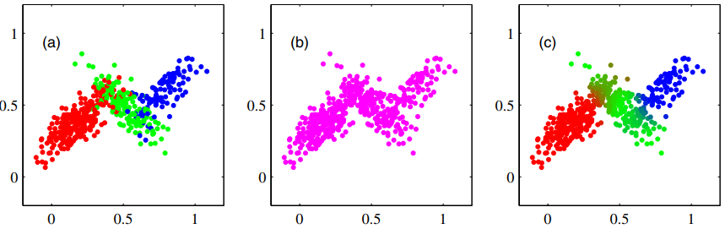
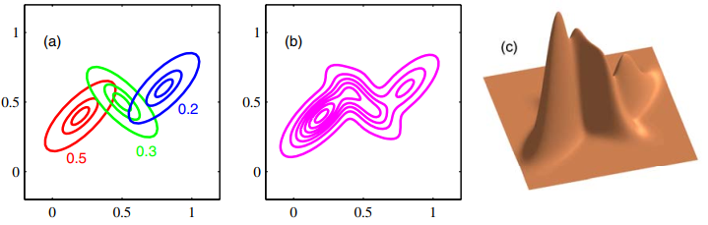








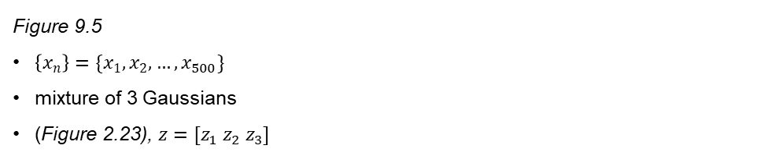

4
Mixtures of Gaussians
Responsibility
Term | Notation
$K$-dimensional binary random variable | $z=[z_{1}{ z}_{2}…z_{K}]$, $z_{k}∈\{0,1\}$
marginal distribution for $z$ | $$p(z)$$
conditional distribution | $$p\left(x | z\right)$$
joint distribution | $$p(x,z)$$
mixing coefficients | $$π_{k}$$
responsibility $k$th Gaussian component taking for $x$ | $$γ\left(z_{k}\right)=p\left(z_{k}=1|x\right)$$
$$z$$
marginal distribution for $x$
observed variables $\left\{x_{n}\right\}=\{x_{1},x_{2},…,x_{N}\}$ → corresponding latent variables $\left\{z_{n}\right\}=\{z_{1},z_{2},…,z_{N}\}$
How to compute $p(z)$ and $p\left(x | z\right)$ ?
EM algorithm
Responsibility → Bayes’ theorem
equivalent formulation of the Gaussian mixture involving an explicit latent variable.
joint distribution $p(z)p(x|z)$
marginal distribution $p(x)$
conditional distribution $γ\left(z_{k}\right)$
$$z_{3}=1$$
$$γ\left(z_{n3}\right)$$
$$z_{1}=1$$
$$z_{2}=1$$
$$γ\left(z_{n2}\right)$$
Complete dataset
Incomplete dataset
$$γ\left(z_{n1}\right)$$
Figure 9.5
$\left\{x_{n}\right\}=\{x_{1},x_{2},…,x_{500}\}$
mixture of 3 Gaussians
(Figure 2.23), $z=[z_{1}{ z}_{2} z_{3}]$
Notes:
大K个Gaussian distribution按混合系数$π_{k}进行$混合
小z的第k项($z_{k}$)等于1的概率是$π_{k}$
对联合概率分布$p(x,z)$操作，不需要再对x的边缘概率分布$p\left(x\right)$操作, 计算上会极大简化
责任：给定x的条件下, z的条件概率，也就是$z_{k}=1$的后验概率。例如x是红色，那么由绿色/蓝色/红色分量生成该x的概率。
可见，z分量决定了着色，因此，在联合概率分布中，只要忽略z的着色值，就可以得到x的边缘概率分布
$γ\left(z_{n1}\right)=1的$点会被标记为红色

Slide 9

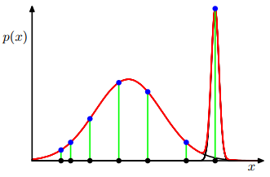
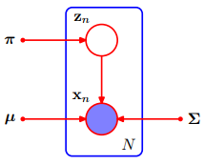


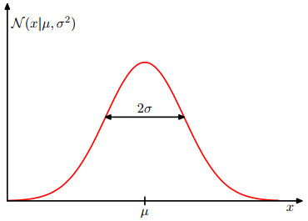
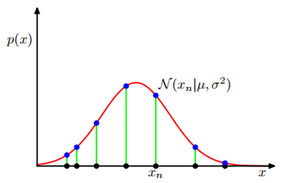











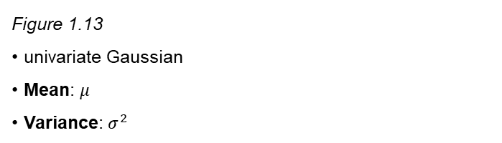
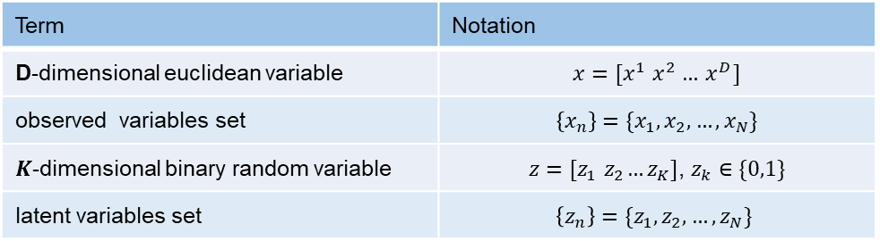



4
Problem 1: singularities occur whenever one of the Gaussian components ‘collapses’ onto a specific data point
Mixtures of Gaussians
Maximum likelihood
Term | Notation
D-dimensional euclidean variable | $$x=[x^{1}{ x}^{2 }…{ x}^{D}]$$
observed variables set | $$\left\{x_{n}\right\}=\{x_{1},x_{2},…,x_{N}\}$$
$K$-dimensional binary random variable | $z=[z_{1}{ z}_{2}…z_{K}]$, $z_{k}∈\{0,1\}$
latent variables set | $$\left\{z_{n}\right\}=\{z_{1},z_{2},…,z_{N}\}$$
$${\left[\begin{matrix}\begin{matrix}x_{11} \\ x_{21}\end{matrix} & ⋯ & \begin{matrix}x_{1D} \\ x_{2D}\end{matrix} \\ ⋮ & ⋱ & ⋮ \\ \begin{matrix}x_{n1} \\ x_{N1}\end{matrix} & ⋯ & \begin{matrix}x_{nD} \\ x_{ND}\end{matrix}\end{matrix}\right]}_{N×D}$$
$$z$$
$$x_{n}=[\begin{matrix}x_{n1} \\ x_{n2} \\ \begin{matrix}⋮ \\ x_{nD}\end{matrix}\end{matrix}]$$
$${x_{n}}^{T}$$
$${x_{n} }^{T}=[\begin{matrix}x_{n1} & x_{n2}\end{matrix}\begin{matrix} … & x_{nD}\end{matrix}]$$
$${\left[\begin{matrix}\begin{matrix}z_{11} \\ z_{21}\end{matrix} & ⋯ & \begin{matrix}z_{1K} \\ z_{1K}\end{matrix} \\ ⋮ & ⋱ & ⋮ \\ \begin{matrix}z_{n1} \\ z_{N1}\end{matrix} & ⋯ & \begin{matrix}z_{nK} \\ z_{NK}\end{matrix}\end{matrix}\right]}_{N×K}$$
$$z_{n}=[\begin{matrix}z_{n1} \\ z_{n2} \\ \begin{matrix}⋮ \\ z_{nK}\end{matrix}\end{matrix}]$$
$${z_{n}}^{T}$$
$${z_{n} }^{T}=[\begin{matrix}z_{n1} & z_{n2}\end{matrix}\begin{matrix} … & z_{nK}\end{matrix}]$$
singularities
Max log of the likelihood function of mixtures of Gaussians
Covariance matrices of $k$th Gaussian:
Mean of $j$th Gaussian:
Max log of the likelihood function of Gaussians
Figure 9.6
Gaussian mixture model
$N$ i.i.d. (independent and identically distributed) data points $\{x_{n}\}$
latent points $\left\{z_{n}\right\}$
$$\lim_{σ_{j}→0}{ =∞}$$
Figure 1.13
univariate Gaussian
Mean: $μ$
Variance: $σ^{2}$
set the derivatives of the log likelihood to 0
Notes:
混合高斯模型的最大似然框架会受到奇异性的影响
如果单⼀的⾼斯分布退化到了⼀个数据点上，那么它总会给由其他数据点产⽣的似然函数贡献可乘的因⼦，这些因⼦会以指数的速度趋于零，从⽽使得整体的似然函数趋于零⽽不是⽆穷⼤。
在混合概率分布中存在（⾄少）两个分量，其中⼀个分量会具有有限的⽅差，因此对所有的数据点都会赋予⼀个有限的概率值，⽽另⼀个分量会收缩到⼀个具体的数据点，因此会给对数似然函数贡献⼀个不断增加的值。
解决办法：
使⽤贝叶斯⽅法，那么这种困难之处就不会出现
使⽤合适的启发式⽅法来避免这种奇异性 （如果检测到⾼斯分量收缩到⼀个点，那么就将它的均值重新设定为⼀个随机选择的值，并且重新将它的⽅差设置为某个较⼤的值，然后继续最优化。） 5.最⼤化⾼斯混合模型的对数似然函数⽐单⼀的⾼斯分布的情形更加复杂。困难来源于在公式（9.14）中，对k的求和出现在对数计算内部，从⽽对数函数不再直接作⽤于⾼斯分布。

Slide 10













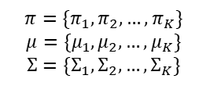








4
Mixtures of Gaussians
Expectation-Maximization (EM)
Term | Notation
D-dimensional euclidean variable | $$x=[x^{1}{ x}^{2 }…{ x}^{D}]$$
observed variables set | $$\left\{x_{n}\right\}=\{x_{1},x_{2},…,x_{N}\}$$
$K$-dimensional binary random variable | $z=[z_{1}{ z}_{2}…z_{K}]$, $z_{k}∈\{0,1\}$
latent variables set | $$\left\{z_{n}\right\}=\{z_{1},z_{2},…,z_{N}\}$$
Mixtures of Gaussians
component of the mixture: Gaussian density$𝓝(X|μ_{k},Σ_{k})$
Mean: covariance matrix:
Step 2: update $μ_{k}$
Step 3: update $Σ_{k}$
Step 4: update $π_{k}$
Step 5: update $γ(z_{k})$
$$z$$
$$Σ_{k}={\left[\begin{matrix}\begin{matrix}Σ_{11} \\ Σ_{21}\end{matrix} & ⋯ & \begin{matrix}Σ_{1D} \\ Σ_{1D}\end{matrix} \\ ⋮ & ⋱ & ⋮ \\ \begin{matrix}Σ_{n1} \\ Σ_{D1}\end{matrix} & ⋯ & \begin{matrix}Σ_{nD} \\ Σ_{DD}\end{matrix}\end{matrix}\right]}_{D×D}$$
$μ_{k}=[μ_{k1}{ μ}_{k2} … μ_{kD}]$
Max log of the likelihood function of mixtures of Gaussians
How to find maximum likelihood solutions: optimal $(π,μ,Σ)$
Step 1
M step
$$π=\{π_{1},π_{2},…,π_{K}\}$$
$$μ=\{μ_{1},μ_{2},…,μ_{K}\}$$
$$Σ=\{Σ_{1},Σ_{2},…,Σ_{K}\}$$
$$max$$
$$\sum_{k=1}^{K}{}$$
$$\sum_{k=1}^{K}{}$$
$$π_{k}$$
$$\sum_{k=1}^{K}{}$$
$$π_{k}∙$$
$${∙π}_{k}$$
responsibility
$$\frac{∂ln⁡p(X|π,μ,Σ)}{∂μ_{k}}=$$
responsibility
E step

Slide 11
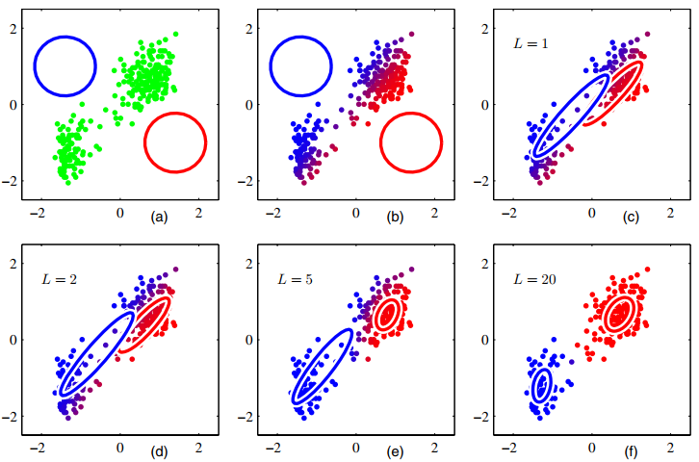

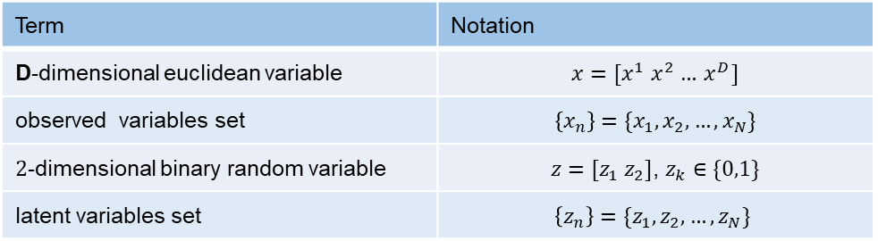




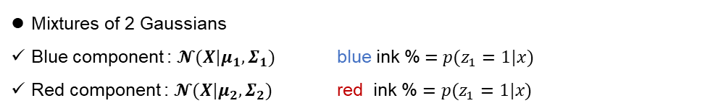


4
Mixtures of Gaussians
Expectation-Maximization (EM)
Term | Notation
D-dimensional euclidean variable | $$x=[x^{1}{ x}^{2 }…{ x}^{D}]$$
observed variables set | $$\left\{x_{n}\right\}=\{x_{1},x_{2},…,x_{N}\}$$
$2$-dimensional binary random variable | $z=[z_{1}{ z}_{2}]$, $z_{k}∈\{0,1\}$
latent variables set | $$\left\{z_{n}\right\}=\{z_{1},z_{2},…,z_{N}\}$$
Mixtures of 2 Gaussians
Blue component : $𝓝(X|μ_{1},Σ_{1})$ blue ink %$=p(z_{1}=1|x)$
Red component : $𝓝(X|μ_{2},Σ_{2})$ red ink % $=p(z_{1}=1|x)$
$$z$$
Step 2: update $μ_{k}$
Step 3: update $Σ_{k}$
Step 4: update $π_{k}$
Step 5: update $γ(z_{k})$
$$z_{1}$$
initialize
1st E step
1st M step
M step
$$Σ_{1}$$
$$γ(z_{2})$$
$$Σ_{2}$$
$$γ(z_{1})$$
$$z_{2}$$
$$max$$
2nd E step
5th E step
20th E step
$$\sum_{k=1}^{K}{}$$
$$\sum_{k=1}^{K}{}$$
$$π_{k}$$
$$\sum_{k=1}^{K}{}$$
$$π_{k}∙$$
$${∙π}_{k}$$
responsibility
E step

Slide 12
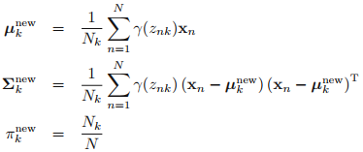






6
Conclusion
Initialize
E step
M step
Evaluate log likelihood
Initialize
means $μ_{k}$
Covariances $Σ_{k}$
mixing coefficients $π_{k}$
evaluate the initial value
log likelihood $ln⁡p(X|π,μ,Σ)$
Evaluate responsibilities
$$p\left(z_{nk}=1 | x_{n}\right)=$$
update parameters
Evaluate $ln⁡p(X|π,μ,Σ)$

Slide 13



Thank you !
Mengdie Huang
Group AI Security
Lab Ruiyun
2020-10-20

